Slide 1

MTN-025/HOPE
Participant Retention
Notes:
Retention definitions
Retention strategies
Participant transfers
Termination & withdrawals

Slide 2

HOPE Accrual Targets
REMINDER!
There are no set accrual targets for HOPE. The goal is to offer participation to all former ASPIRE participants, not enroll a certain number of former participants.
Notes:
The key is to fully educate about HOPE and allow participants the opportunity to join, not to push enrollment on participants who may not be interested.

Slide 3

What do we mean by retention in HOPE?
Notes:
In ASPIRE, retention goals were 95% each month – so that all participants could be using the ring (with or without active study drug). How does this retention goal fit in HOPE?

Slide 4
What do we mean by retention in HOPE?
The term “retention” refers to completion of required follow-up visit procedures at the time points specified in the protocol. In HOPE, the retention target is still 95%.
The difference?
We want women to complete their study visits and procedures – whether it is decliner procedures, non-acceptors, or ring users, to both support them to follow their HIV prevention plan, and to gather more information about the ring & its use in a real-world setting. We don’t want to retain participants to pressure them into participating in the study or using the ring!

Slide 5
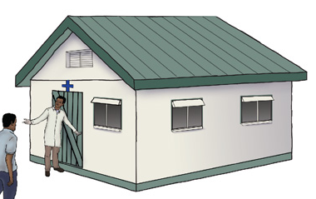
What might effect a participant’s retention in HOPE?

Slide 6

What might effect a participant’s retention in HOPE?
  Social Harm
  Feeling pressure or judgment from HOPE team
  Ease/ difficulty of ring use
  Ease/difficulty/length of clinic visits and/or study procedures
  Anything else?

Slide 7

During ASPIRE, what worked to keep participants motivated?

Slide 8

During ASPIRE, what worked to keep participants motivated?
  Community Events & working with the community
  Phone calls & SMS reminders
  Comfortable clinic visits
  Good rapport between participants and staff
  What else?

Slide 9

During HOPE, what might we try to encourage retention?

Slide 10

During HOPE, what else might we try to encourage retention?
  Maintain supportive Options Counseling
  Participant engagement events
  Work with local service providers to support participants
  Schedule convenient visits
  Host male involvement events
  What else?

Slide 11


Participant Transfers
If a participant is relocating, check to see if a transfer to another HOPE site is possible before terminating her participation in the study.
If she is able and willing to transfer, the transferring site should notify the receiving site and the MTN 025 Management Team.
Detailed guidance on participant transfers can be found in SSP Section 6

Slide 12
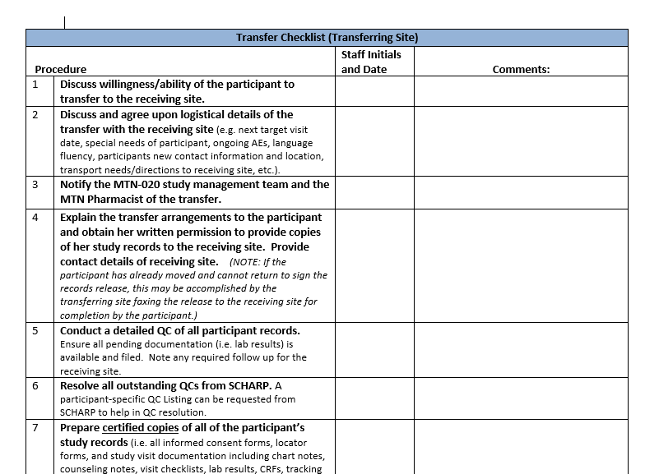
Participant Transfer Checklist
Notes:
A participant transfer checklist & transfer inventory log will be created to assist with participant transfers, and can be found on the MTN website.
This is a sample from ASPIRE, but the checklist for HOPE should be similar.

Slide 13

Termination & Withdrawal
Voluntary Withdrawal
Site teams should help participants work through any challenges to participation.
Ask participant if she is willing to complete one last visit, during which the Early Termination Visit procedures (consisting of PUEV and Termination Visit procedures) would be conducted.
  At minimum, staff should try to perform a final HIV test (two rapid HIV tests) before withdrawal.
Ensure all referrals are provided to participant as needed
Further details on voluntary withdrawal can be found in SSP Section 6.
Notes:
As stated in protocol Section 9.8, participants may voluntarily withdraw from the study (withdraw consent) for any reason at any time. However, sites should make every effort to encourage participants to remain with the study.

Slide 14

Termination & Withdrawal
Early Termination
When considering early termination of participants, weigh the advantages of keeping a participant in the trial against the negative impacts of a participant’s poor retention on study outcomes and clinic resources.
Participant terminations should be viewed as a last resort.
Consultation with the PSRT is required regarding early terminations per IoR decision
Discuss challenging participants and potential terminations as a group and with the study management team, as needed.
Notes:
As specified in protocol section 9.8, the IoR may withdraw participants from the study to protect their safety and/or if they are unwilling or unable to comply with required study procedures, in consultation with the PRST. It is recommended that site IoRs use their discretion with regards to terminating participants who relocate and cannot transfer to another study site or can no longer come to the clinic, and are unlikely to resume study visits after counseling efforts and discussions with appropriate study staff.
Further details on making the decision for early termination, and documenting the process, can be found in SSP Section 6.

Slide 15

Resumptions after Withdrawal
Participants may change their mind and rejoin the study during after early termination/withdrawal
  Participant must re-consent to document that she voluntarily rejoined the study
  PTID and Follow-up visit schedule remain the same
  Clinical exam must be done prior to product restart
Contact MTN-025 mgmt. team and PSRT for detailed guidance
Notes:
If such cases arise, study staff is advised to contact the mtn025mgmt@mtnstopshiv.org for additional guidance on how to manage various aspects of protocol implementation and data collection as the participant resumes participation in the study and to contact the PSRT to determine if the participant can be offered study product. If a participant rejoins the study, her PTID and follow-up visit schedule will remain the same. A clinical examination must be conducted prior to restarting product; procedures required should be confirmed by the PSRT. Resupply should be indicated on the Vaginal Ring Request Slip with a comment clearly stating that the participant has decided to rejoin the study and is clinically eligible to receive study product. If a participant has never previously accepted rings but wants to initiate ring use, a prescription should be completed for this initial dispensation.
Prior to performing any study procedure, the participant must provide written informed consent to document that she voluntarily rejoined the study. For re-consenting procedures, refer to Section 5.10 of this study manual.
Site staff should thoroughly document in the participant’s chart notes her resumption of study follow-up, and if applicable, study product use and all communication with the study management team and PSRT.

Slide 16


Retention Pop Quiz
Get out your quiz paper!

Slide 17

Retention Pop Quiz
What important factors may effect a participant’s retention in HOPE?

Slide 18

Retention Pop Quiz
For a participant who transfers from one site to another, what PTID will she use at the new site?

Slide 19

Retention Pop Quiz
What is the retention goal in HOPE?

Slide 20
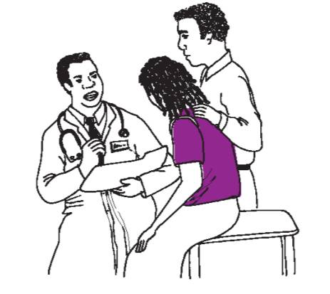
Retention Pop Quiz
What should be requested of someone who withdraws from the HOPE study?

Slide 21

Retention Pop Quiz
Name one activity at your site that you feel was the most successful at encouraging participant retention during ASPIRE.
Notes:
.

Slide 22

Retention Pop Quiz
How did you do?
Varied – please share!
She keeps the same PTID
The retention goal in HOPE is 95%
Request that she complete an early term visit, and if not, a minimum of 2 rapid HIV tests should be conducted before participants withdraw from the study.
Varied – please share!
Notes:
Note for #4 – this is what sites should try to get from all participants, although we realize that it may not be possible in all instances.

Slide 23

Any further questions?

